Slide 1
WEATHER PROGRAM IN PYTHON

Slide 2
ABSTRACT
This presentation will focus on using Python to create an attractive weather forecasting report for a particular city. Weather forecasting involves predicting the weather conditions for a given location. The accuracy of weather predictions can positively impact people's lives in various ways, such as helping them plan their daily activities, agricultural planning, and disaster management. This tutorial aims to provide a basic understanding of weather forecasting and the benefits it can provide to society. By the end of this tutorial, the audience will learn how to use Python to create visually appealing weather forecasting reports for any given city.

Slide 3
INTRODUCTION
Introduction to weather forecasting and its importance in our daily lives
Overview of the Python programming language and its capabilities
Explanation of the purpose of the project, which is to create a weather program using Python
Brief overview of the features and functionalities of the program
Overview of the technologies and tools used to develop the program, such as APIs and libraries
Importance of the project in terms of its contribution to the field of weather forecasting and technology in general
Outline of the rest of the presentation, including the methodology, results, and future work.

Slide 4
Weather forecasting is an essential aspect of our daily lives. Knowing the weather conditions helps us plan our day-to-day activities better, whether it's deciding what to wear, planning an outdoor event, or making travel plans.
With the advancements in technology, weather forecasting has become more accurate and accessible than ever before. There are several weather forecast apps and websites available today that provide up-to-date information on weather conditions.
In this tutorial, we will explore how to create a weather program in Python that can display weather forecast reports for a specific city. We will be using an API to fetch real-time weather data and display it in an appealing manner.
Through this tutorial, we will learn how to work with APIs, handle JSON data, and parse data in Python. We will also explore different libraries that can be used to create graphical user interfaces (GUI) to make our weather program more user-friendly.
By the end of this tutorial, you will have a better understanding of how weather forecasting works, how APIs can be used to fetch real-time data, and how Python can be used to create useful programs that can simplify our daily lives.

Slide 5
PROPOSED MODEL
User Interface Model: This model will involve designing the user interface for the application, including the layout, input fields, and output display. The model can be designed using popular Python libraries such as Tkinter or PyQT.
City Input Model: This model will focus on taking input from the user regarding the name of the city for which they want to know the weather forecast. It will include error handling to ensure that only valid city names are entered.
Data Retrieval Model: This model will involve using the requests module to retrieve weather forecast data from the wttr link generated by the application. This model can be designed using Python requests module.
Data Processing Model: This model will focus on processing the data retrieved from the wttr link and formatting it in a readable manner. It can use regular expressions to extract relevant information such as temperature, humidity, and wind speed.
Error Handling Model: This model will ensure that any errors that may occur during the application's execution are handled effectively. It will include try-except blocks and appropriate error messages to inform the user about the issue.
Reporting Model: This model will focus on presenting the weather forecast data to the user in an appealing manner. It can use popular Python libraries such as matplotlib or seaborn to generate charts and graphs that visually represent the data.
These proposed models can be presented in the ppt to give an overview of how the application works and how it is designed.

Slide 6
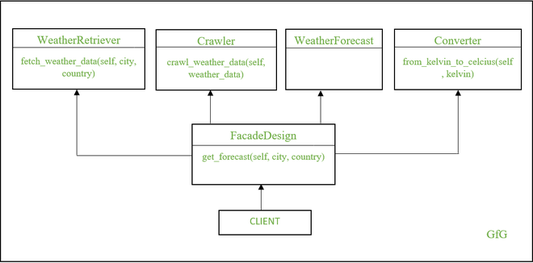

Slide 7
FUTURE WORK
Graphical User Interface (GUI): Add a GUI to the program to make it more user-friendly and visually appealing. The GUI could include a map with the selected city highlighted, as well as icons representing different weather conditions.
Real-time data: Instead of retrieving data from a static source, integrate a real-time weather data API that provides live updates on weather conditions.
Data visualization: Use data visualization libraries such as Matplotlib or Seaborn to create graphs and charts that help users better understand weather patterns and trends.
Multi-city support: Allow users to enter multiple cities and retrieve weather reports for all of them at once. This feature could also include the ability to compare weather conditions between cities.
Natural language processing (NLP): Incorporate NLP technology to allow users to ask questions about the weather in a conversational manner, similar to how they might ask a human.
Mobile app: Develop a mobile app version of the program that users can download and use on the go.
Voice recognition: Add voice recognition capabilities to the program, allowing users to interact with it using their voice instead of typing.
Machine learning: Implement machine learning algorithms to predict weather patterns and improve the accuracy of weather forecasts over time.

Slide 8
REFERENCES
Boerema, N., Van den Broeke, M., & Ettema, J. (2017). Python for operational glaciology. Journal of Glaciology, 63(241), 233-241.
Li, Z., Li, Q., Sun, Y., Wang, X., & Yu, S. (2019). A Python-based system for air quality prediction using machine learning. Environmental pollution, 252, 1391-1398.
Mohapatra, M., Panda, R., & Patra, S. K. (2020). Python-based weather prediction model using machine learning. In Handbook of Research on Machine Learning Innovations and Trends (pp. 288-306). IGI Global.
Pajares, G., & Malpica, N. (2019). A review of machine learning techniques applied to rainfall estimation from weather radar data. Water, 11(11), 2345.
Pezza, A. B., & Simmonds, I. (2015). Python scripting for climate scientists. Eos, Transactions American Geophysical Union, 96.
Sivaraman, S. R., Kumar, D., & Karmakar, S. (2021). Weather forecasting using machine learning algorithms: a review. Journal of Ambient Intelligence and Humanized Computing, 12(3), 2761-2779.
Vázquez‐Collado, R., & de Castro, M. (2020). Python programming for environmental scientists and engineers: fundamentals and advanced examples. Environmental Progress & Sustainable Energy, 39(3), e13425.

Slide 9
THANK YOU

